Slide 1
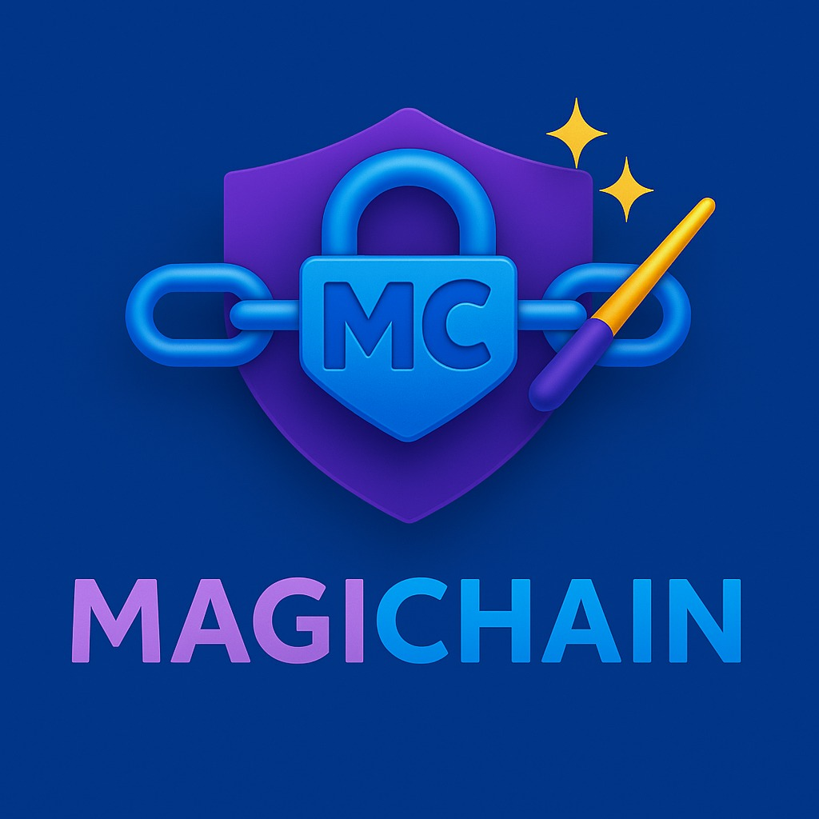
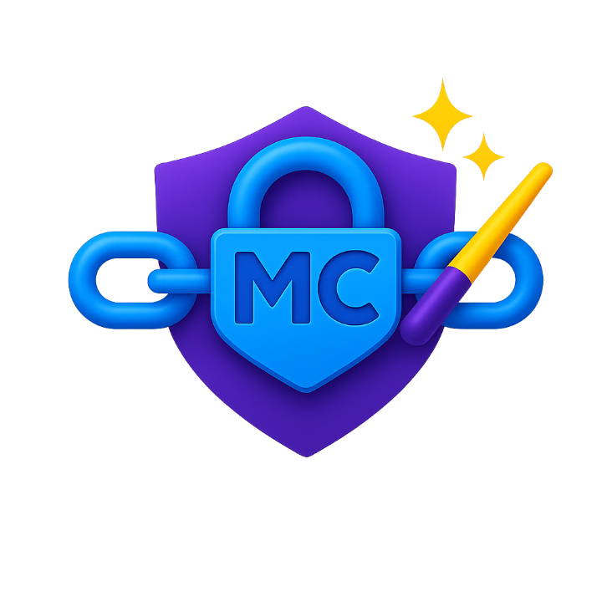
Bulletproof Security. Smart Contract Validation.
Notes:
1

Slide 2





Our Team
Daniel Shapiro –Elite tech unit R&D Captain, Technion CS grad (Psagot Broshim Honors), 10+ years of experience in cyber, CheckPoint
Ido Eilon – Technion CS student, President’s Honor List. Entrepreneurial technologist with a top-tier academic record and hands-on experience in AI and product development.
Tal Kaniel– 8200 Gamma Software Developer, first in class cyber officer course, Full Stack Engineer
Yaniv Kaniel – Technion CS student , Lapidim Honor Student, Duvdevan Special forces soldier, MOBILEYE Software Developer
Yuval Gabay – Unit 81 officer, CS grad, 5+ years of experience in
Embedded & R&D

Slide 3
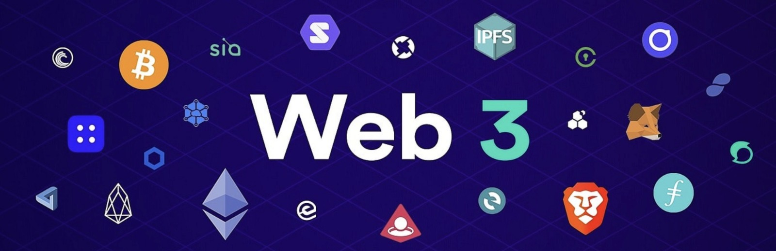
The Next Internet
“Smart contracts are bits of code that run money. Once deployed, they can’t be undone.”
Notes:
“Smart contracts are bits of code that run money. Once deployed, they can’t be undone.”
They power the future of apps, finance, games, and more.
3

Slide 4
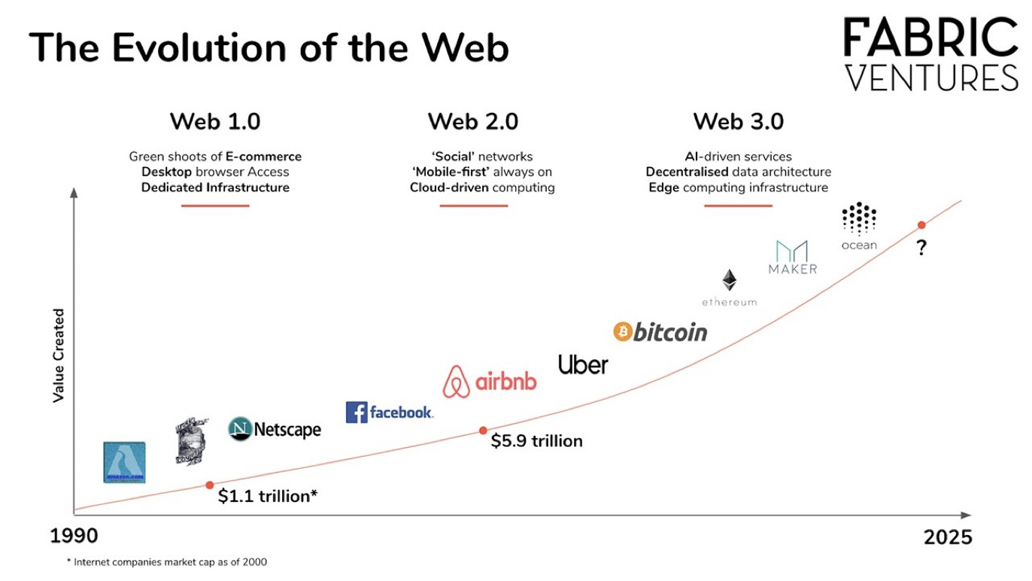
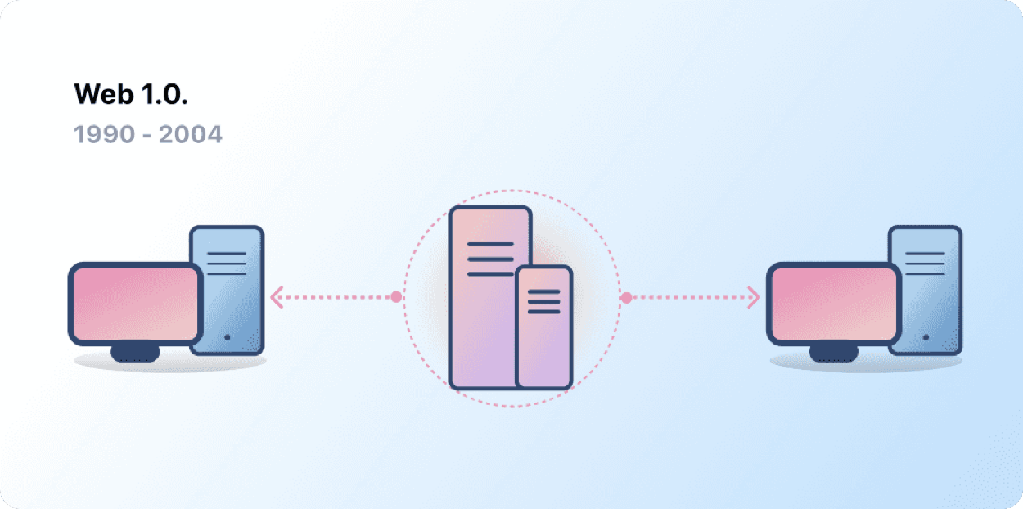
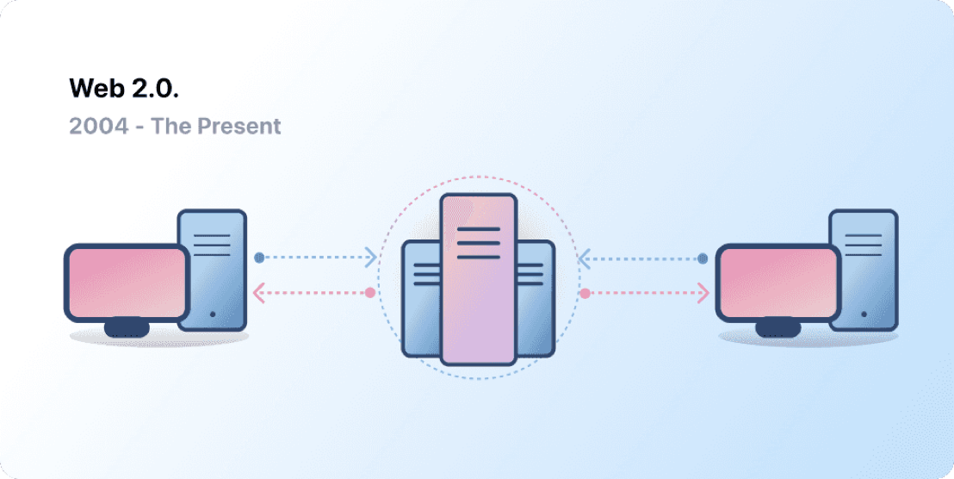
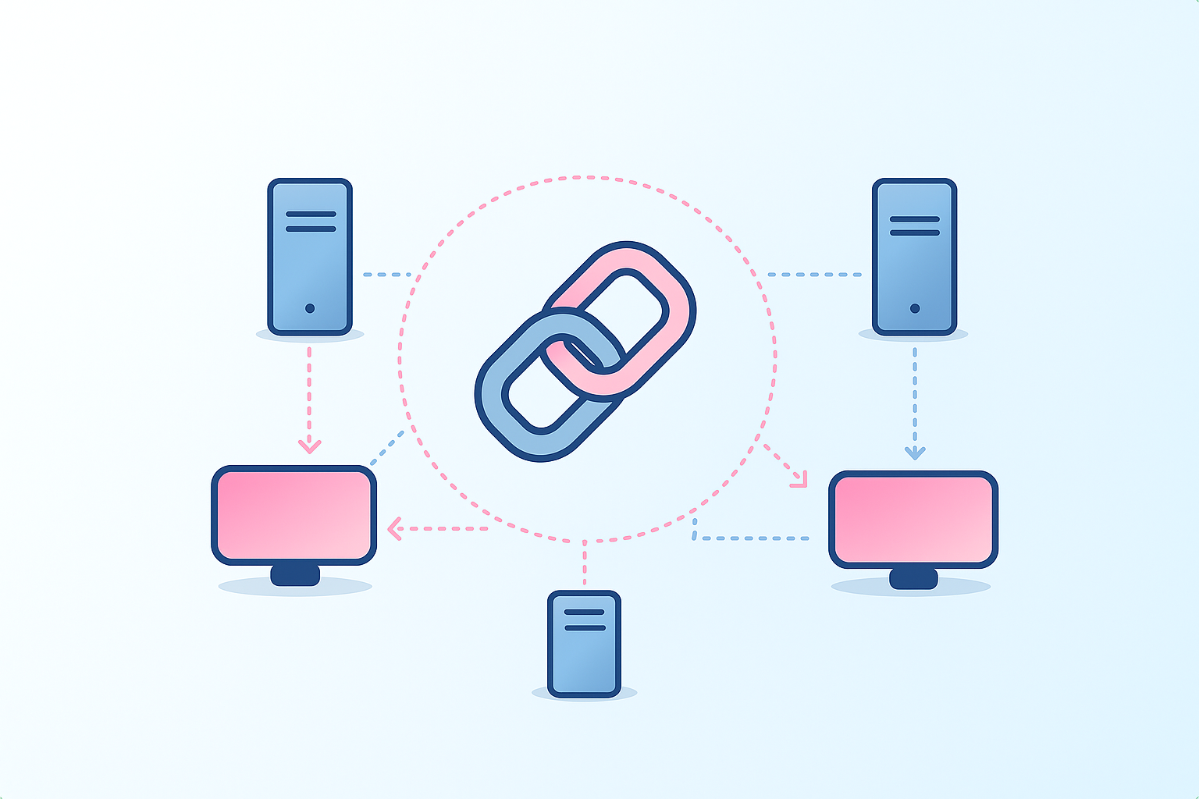


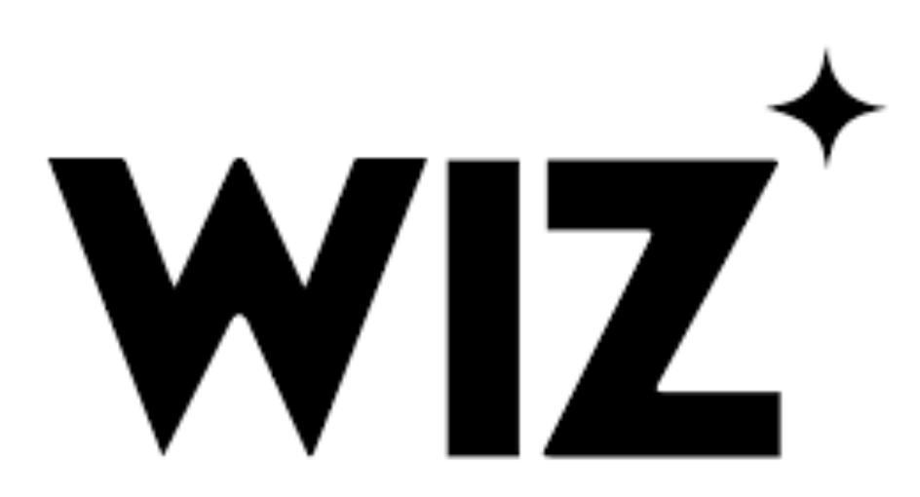

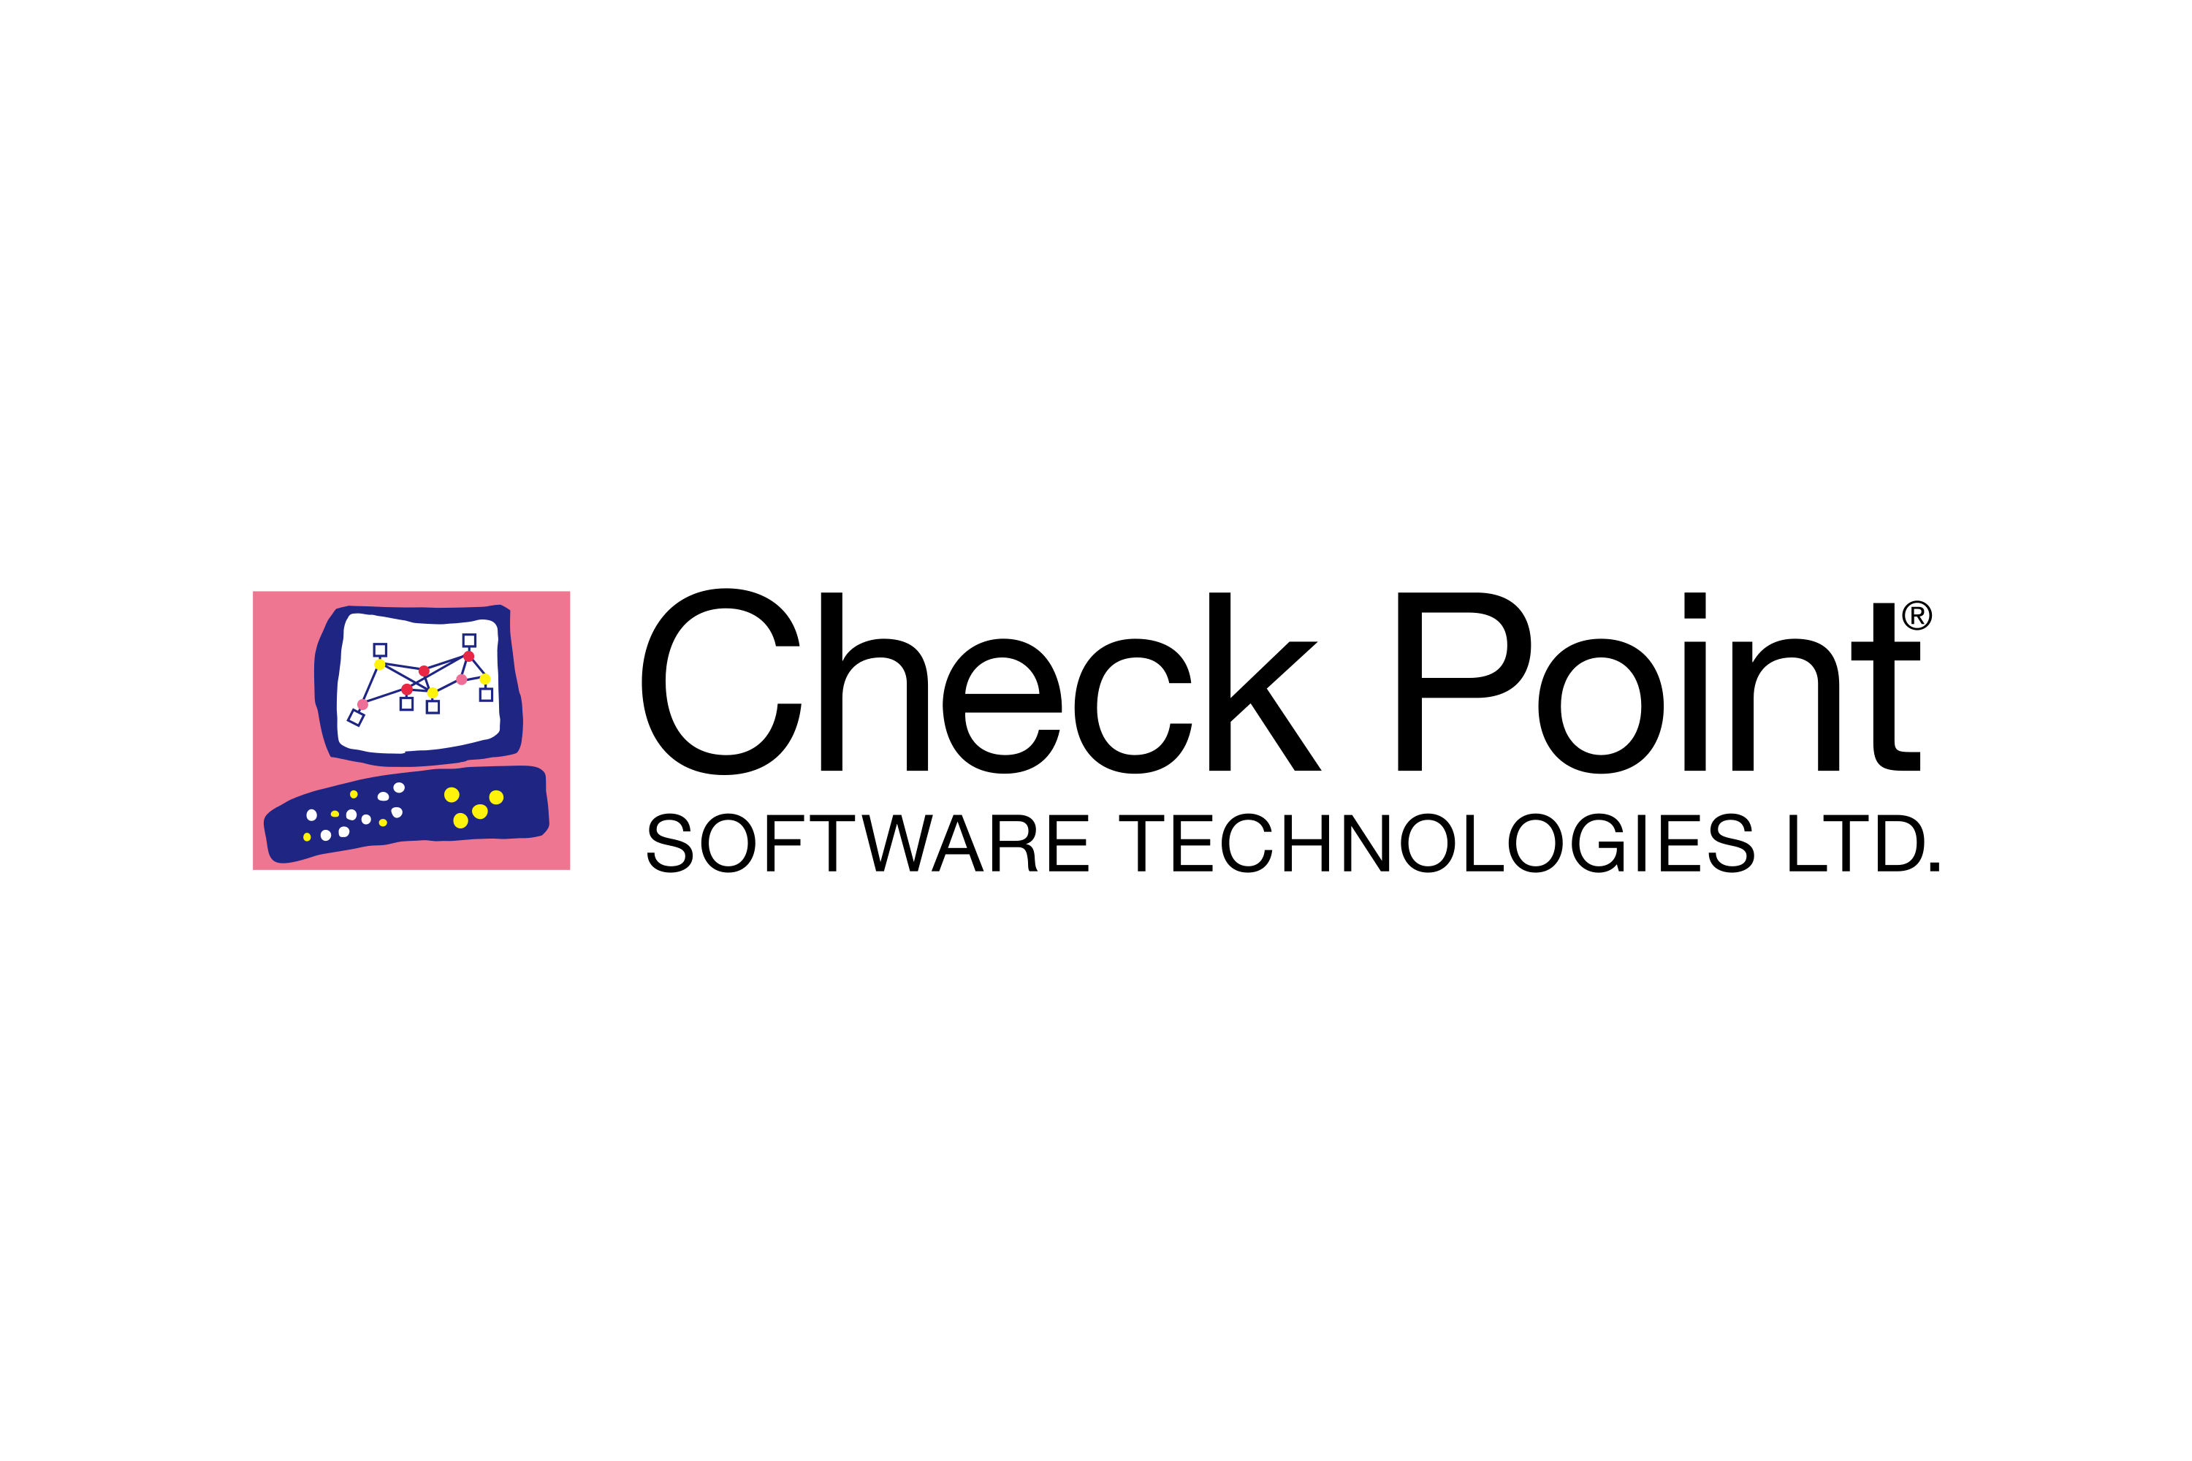
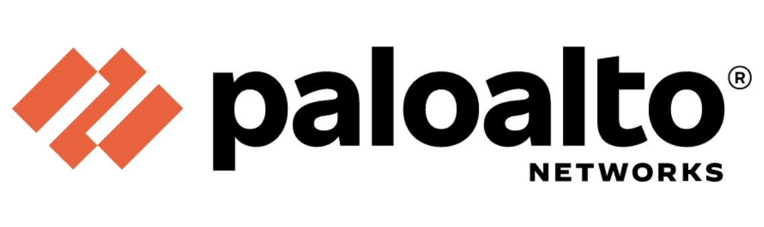


The Next Internet
“Smart contracts are bits of code that run money. Once deployed, they can’t be undone.”
2030
Notes:
“Smart contracts are bits of code that run money. Once deployed, they can’t be undone.”
They power the future of apps, finance, games, and more.
Todo – add checkpoint, palo alto, google security
4

Slide 5
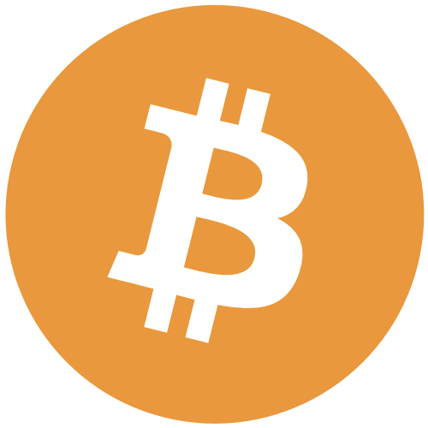

Bitcoin Blockchain

Slide 6
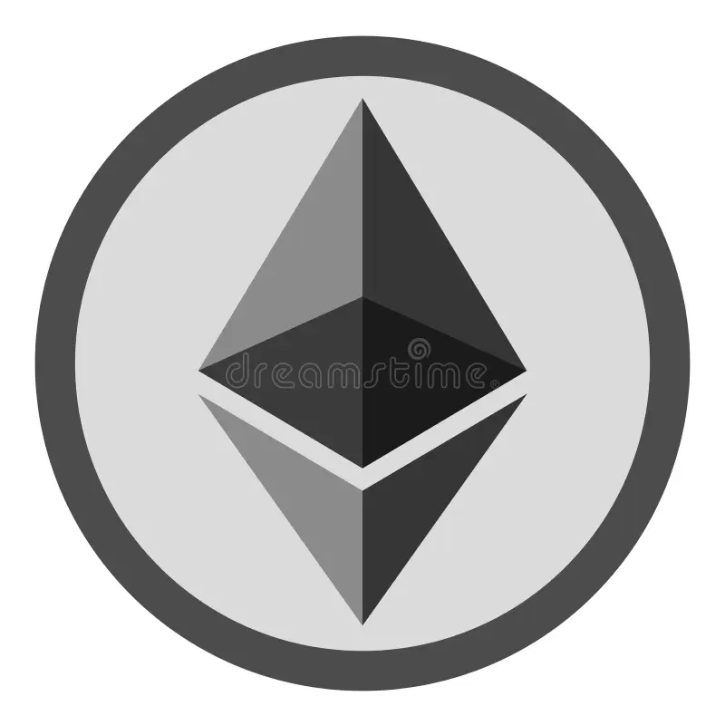

Smart Contracts – Democratic Market for Computation
Notes:
Bitcoin, Ethereum, and other blockchain platforms offer enhanced security due to its
decentralized, encrypted, immutable democratic nature. Throughout the evolution of the
web3 ecosystem additional problems came to light such as smart contract security,
privacy, and ability to scale. Solutions for privacy and ability to scale transactions have
been proposed. However as this ecosystem continues to evolve and develop the security
issues of smart contract deployments have not been solved.
6

Slide 7

The Big Picture
Billions move through smart contracts. One bug = total loss.
Smart contracts form the foundation of the new internet

Slide 8
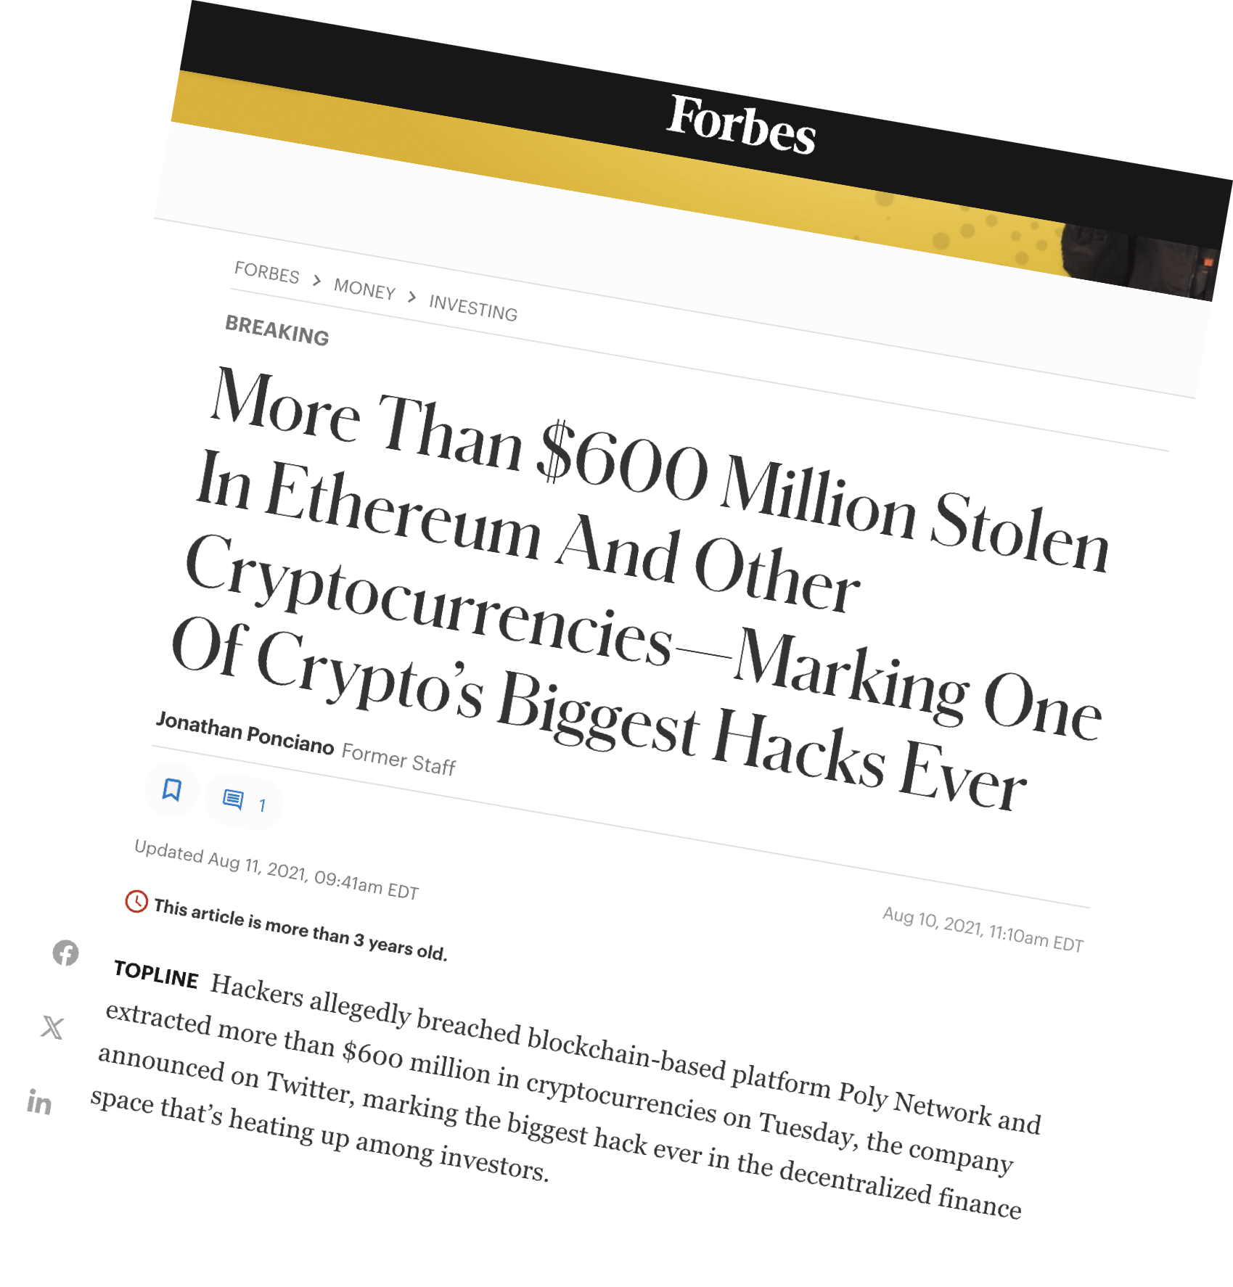
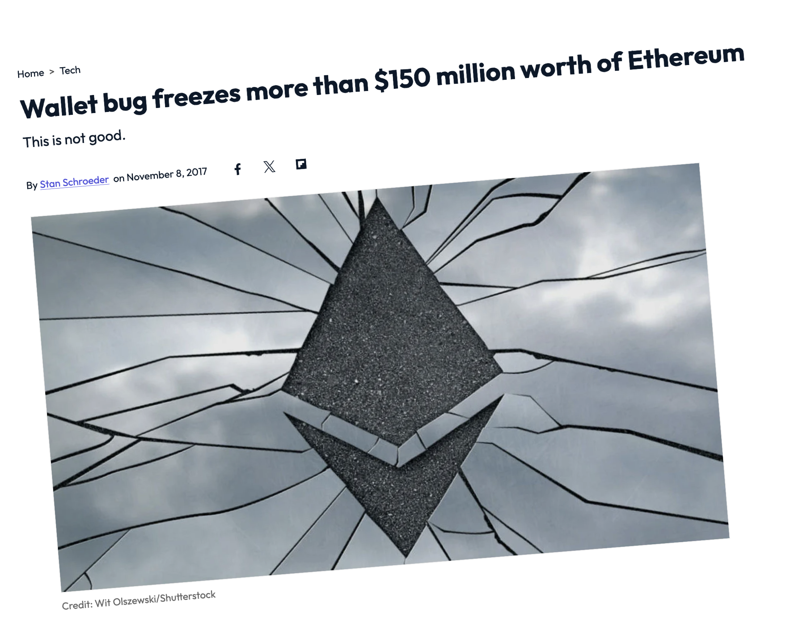
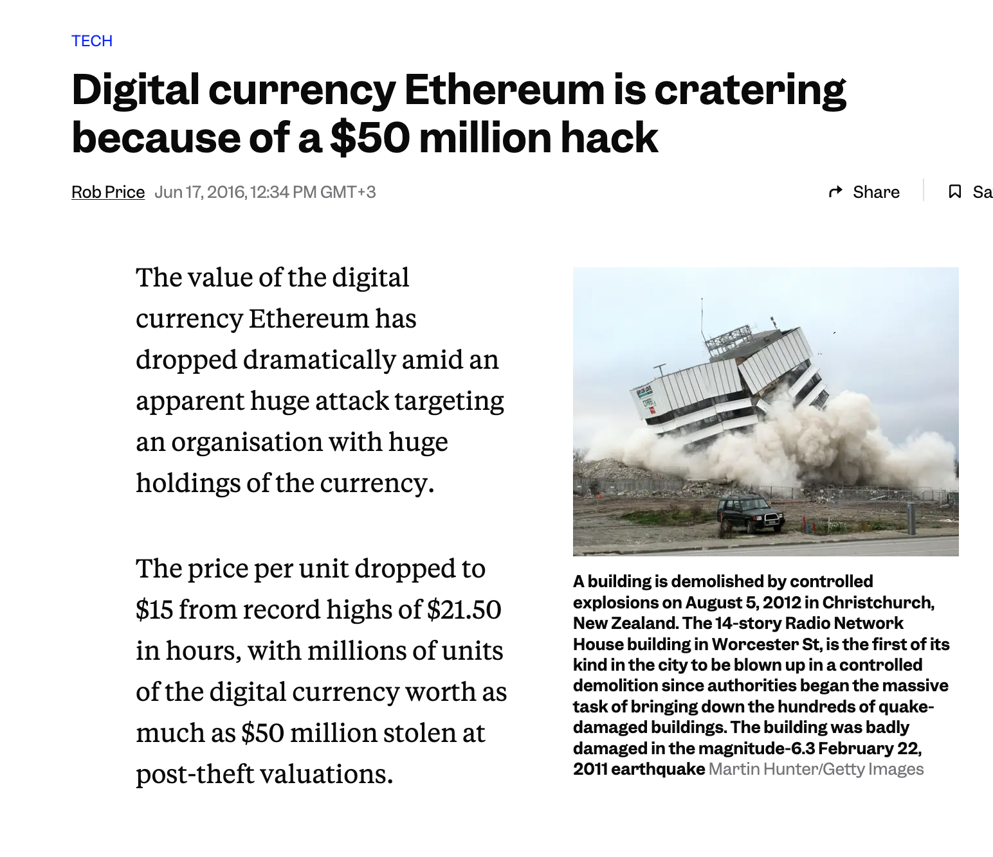
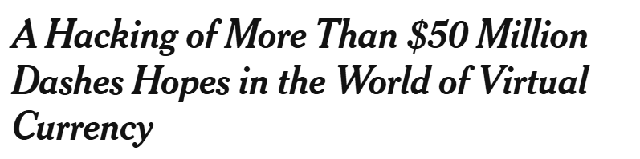
The problem:
The New York Times, June 17th 2016
Notes:
Code is immutable once deployed
- $2.25B+ lost in smart contract hacks annually
While Ethereum and similar blockchain platforms offer powerful tools, they also present
an immense attack surface. Smart contracts, once deployed, are immutable and
dispersed universally while handling billions of dollars in digital assets. A single
vulnerability can result in catastrophic losses, as evidenced by numerous high-profile
exploits that have cost the industry hundreds of millions of dollars.
There is no mechanism in the underlying blockchain algorithm or infrastructure that
inspects the smart-contract itself and automatically ensures the validity and safety of it.
8

Slide 9

The Solution : AntiVirus for Web3 Transactions
Leveraging of Academic Research
Mathematical Formal Logic-Based Proofs
Innovative enterprise-grade validations
Seamless Integration
Notes:
A security solution that does not yet exist today -
“Validation per transaction”
Our idea is to build an “antivirus” or smart verifier for blockchain smart
contracts that would be used to prevent, detect, and remove malware by
validating transactions before they are deployed to blockchain networks
such as Ethereum or those that resemble Ethereum (blockhchains that
possess the quality of built-in fully fledged Turing-completeness).
Additional security features
9

Slide 10
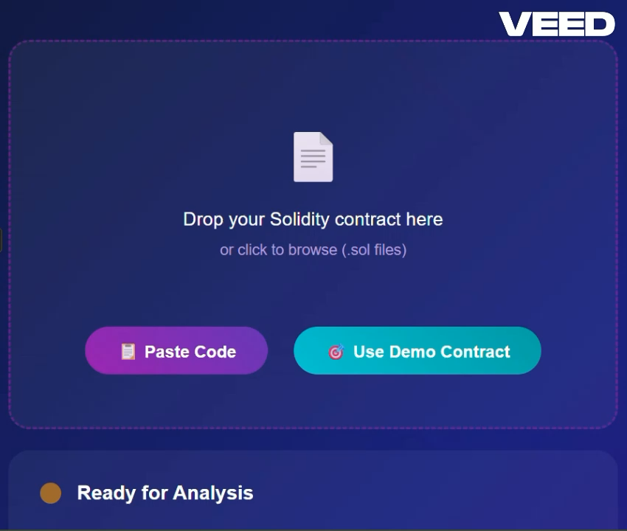
The MagiChain Interface
Notes:
Demo- - Intuitive upload interface
- Plain English vulnerability reports
- Fix recommendations
- Instant deploy to blockchain
Video clip need to edit
10

Slide 11
Market Opportunity
Market Size:
Massive need for secure, scalable smart contract verification
Over 23% CAGR​
2035: $400B – $2.26T
$2.25B/year in contract hacks (average in last 4 years)
Sources:
https://www.researchandmarkets.com/reports/5933935/smart-contracts-market-report
https://www.imarcgroup.com/smart-contracts-market
https://immunefi.com/research/
Notes:
hermetic
11

Slide 12
Business Model
Deployments Cost Money (Gas)
Add 0.08% Commission (Gas) for Each Smart-Contract Validation
Notes:
The web3 market size is currently estimated at USD 4.62 billion in 2025, projecting a
growth to USD 99.75 billion by 2034, with a CAGR of 41.18% from 2025 to 2034 .
Since early 2025, the number of deployed smart contracts on ethereum has
grown from 5K to an average of 100K per day.
Meanwhile, the number of verified contracts stays at ~300 per day, about the
same as a year ago. That means less than 0.5% of contracts are verified daily.
Given those numbers the total amount of gas being invested into smart-contract
deployment per day is at 10,000,000 USD per day.
If we have 2 percent market cap --- Talk to idop
12

Slide 13




Revenue Model
Free Tier: 1 scan/week
Pro Tier: $29/month
Enterprise Tier: API + team tools
Optional revenue stream: % cut from deployments

Slide 14
Financial Roadmap
Projections:
Year 1: .001% Market Cap
$25K MRR
Year 3: .01% Market Cap $250K MRR
Year 6: .1% Market Cap $2.5M MRR
Year 12: 10% Market Cap
$250M MRR
Notes:
14

Slide 15


Competitive Landscape
Trait
Certora
ChainSecurity
MagiChain
Approach
Affordable
speed
Integrity

Slide 16





Why We Win
🧠 AI-generated natural language reports
⚡ Fast + accurate
🎯 User-friendly for solo devs and teams
🧩 CI/CD integration
🧨 Fix suggestions + seamless deployment
Notes:
16

Slide 17









Milestones:
Currently here
R&D Testing + Improvements
Ideation
Specs for proposal
POC
Commercialization
May 2025
March 2026
July 2024
March 2025
October 2025
Initial Technological research
Market research
MVP
Client growth
October 2024
April 2025
August 2025
January 2026
Notes:
17

Slide 18


Ask:
R&D
Marketing
Use Of Funds:
Operations
Funding Ask: $250K until MVP and Commercialization
Team Growth
Be the
Of​
Notes:
18

Slide 19
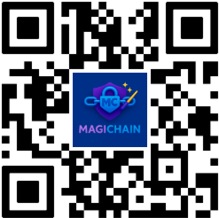
Let’s talk
Visit our website:
Email us at:
info@magichain.net
Notes:
19

